Slide 1

Audio Sentiment Analysis
Team (SONIC SARK’s)
Members Mentor
Mr. Akshay Singh Mr. Prakash Sinha Ms. Khyati Modi
Mr. Rahul Khatkar
Ms. Sneha Swami

Slide 2
Introduction
Emotions are important part of understanding human interactions. Research is going into finding methods that can at the very least mimic human ability to recognise emotions displayed in the form of facial expressions, changes in tone while speaking, etc. Speech Emotion Recognition (SER) is one of such fields. Using deep learning and machine learning algorithms, we aim to design an automatic emotion recognition system.

Slide 3




Dataset Used
1440 speech files
The dataset is built using 2452 samples from:
Ryerson Audio-Visual Database of Emotional Speech and Song (RAVDESS) dataset .
1012 song files
recordings of 24 professional actors (Male & Female)
Emotions including neutral, calm, happy, sad, angry, fearful, surprise, and disgust.

Slide 4
Libraries Used
Librosa : It is a python package for music and audio analysis. It provides the building blocks necessary to analyze information from audio data for further processing.
PyAudio : PyAudio is a set of Python bindings for PortAudio, a cross-platform C++ library interfacing with audio drivers. It is used to directly play audio files in Jupyter Notebook.
SpeechRecognition : To convert audio files to speech.

Slide 5
Features Extracted
1. Chroma feature
A chroma feature or vector is typically a 12-element feature vector indicating how much energy of each pitch class, {C, C#, D, D#, E, …, B}, is present in the signal.
2. Mel-Frequency Cepstral Coefficients(MFCCs)
The Mel frequency cepstral coefficients (MFCCs) of a signal are a small set of features (usually about 10–20) which concisely describe the overall shape of a spectral envelope. It models the characteristics of the human voice.
3. Mel-Spectogram
A mel spectrogram is a spectrogram where the frequencies are converted to the mel scale. Mel scale is a unit of pitch such that equal distances in pitch sounded equally distant to the listener. This is called the mel scale

Slide 6
Methodology / Model Used
The classification model proposed based on
Machine learning
Deep learning strategy.
The project tested 2 models:
Convolutional neural networks (CNN),
MLP classifier.
Feature extracted: Mel-frequency cepstral coefficients (MFCC),Chroma feature, Mel Spectogram
Table 1. shows classes the model wants to predict
 | emotion
1 | Neutral
2 | Calm
3 | Happy
4 | Sad
5 | Angry
6 | Fearful
7 | Disgust
8 | Surprised
Table 1. Emotions to be classified

Slide 7



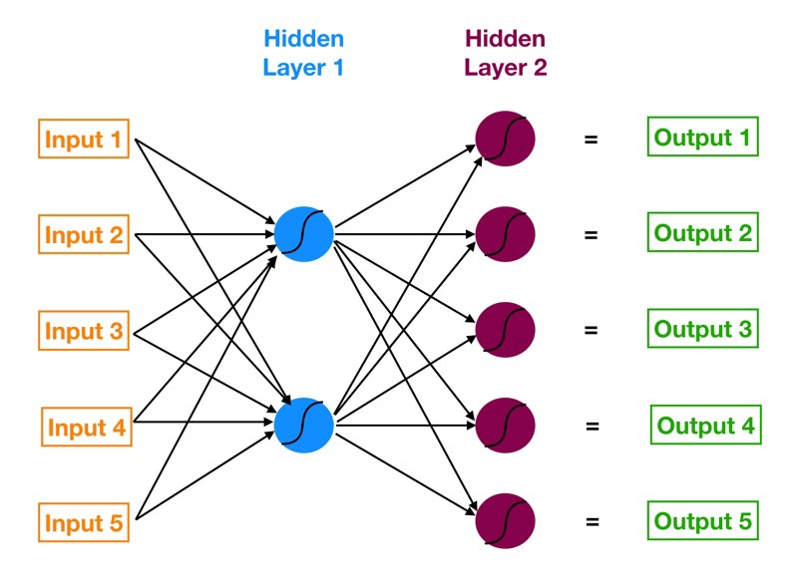


Multilayer Perceptron Classification

Slide 8
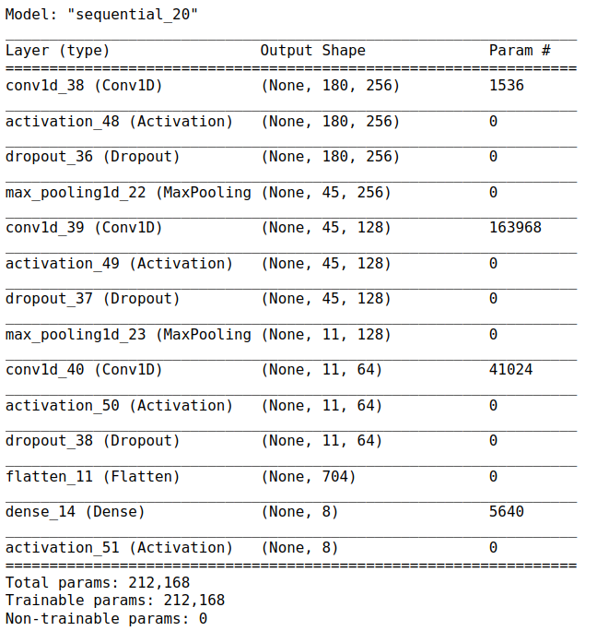
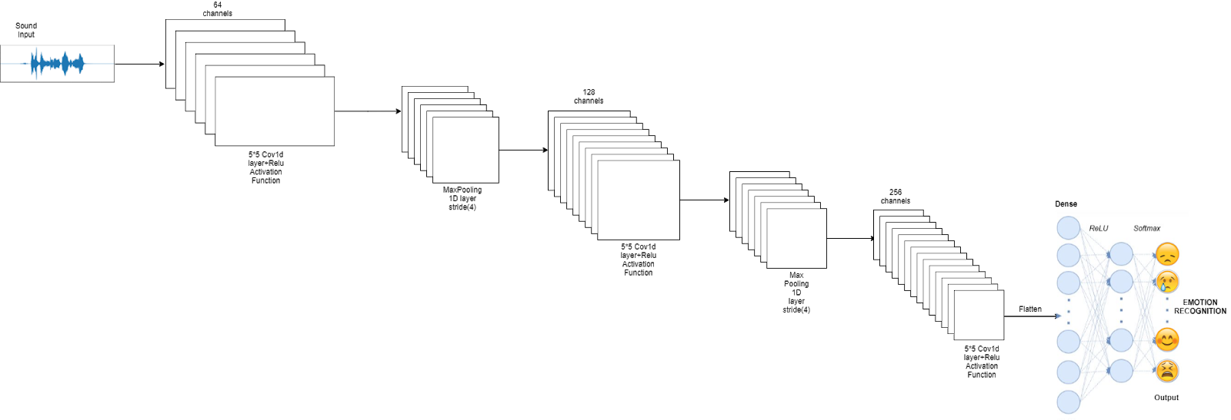
CNN Layer Description

Slide 9
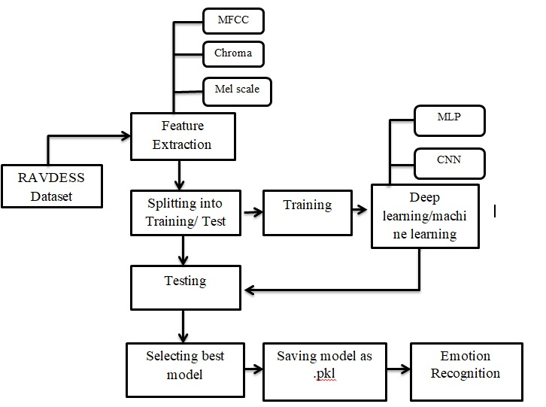
System Architecture
System Design Flowchart
Fig 1. SER system design flowchart

Slide 10



Results Achieved
MLP Classifier achieved an accuracy score of 72.56% over the 8 classes.
Sequential classifier achieved an accuracy score of 73%.
Final choice – MLP classifier that achieved accuracy score of 72%.

Slide 11
On Microphone data
We also took input from microphone for testing of our model.

Slide 12
Conclusions
Approaches based on deep neural networks are an excellent basis for solving the task.
Model is general enough to work in a real application context correctly
Combining the two datasets, RAVDESS Speech & Ravdess Songs, increased accuracy
Removed audio collected from video files from RAVDESS dataset as it caused overfitting
Further Improvement: More data can be collected to increase model accuracy and performance on all emotion classes. Can improve the model further by predicting emotions on real time data. Also can incorporate other learning mechanisms to compute the percentage of emotions for audio with mixed emotion.

Slide 13
Future Scope
1. An accurate implementation of the pace of the speaking can be explored to check if it can resolve some of the deficiencies of the model.
2. Exploring other acoustic features of sound data to check their applicability in the domain of speech emotion recognition. These features could simply be some proposed extensions of MFCC like RAS-MFCC or they could be other features entirely like LPCC, PLP or Harmonic cepstrum.
3. Figuring out a way to clear random silence from the audio clip.
4. An alternate approach that could be explored for this problem is splitting the classifying task into two distinct problems. A separate model could be used to classify gender and then separate models for each gender to classify emotion could be utilized. This could possibly lead to a performance improvement by segregating the task of emotion classification by gender.
6. Adding more data volume either by other augmentation techniques like time-shifting or speeding up/slowing down the audio or simply finding more annotated audio clips.

Slide 14
Applications
1. Virtual assistants Alexa, Siri, and Google Home, are largely products built atop models that can extract information from audio signals.
2. Applications include customer satisfaction analysis from customer support calls, media content analysis and retrieval, medical diagnostic aids and patient monitoring, assistive technologies for people with hearing impairments, and audio analysis for public safety.
3. Indexing music collections according to their audio features.
4. Recommending music for radio channels
5. Similarity search for audio files (aka Shazam)
6. Speech processing and synthesis — generating artificial voice for conversational agents

Slide 15
Thank You

